Slide 1


Big Data for the Common Good
Big Data For the Common Good
Virginia Carlson, CEO Metro Chicago Info Center
@VL_Carlson
Jake Porway, Data Without Borders
@DataNoBorders

Slide 2
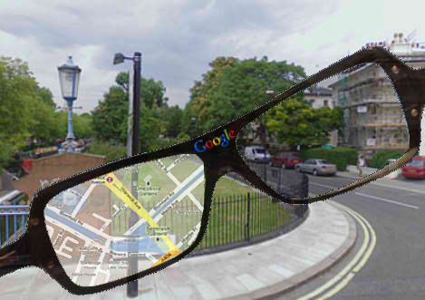

The Data-Driven World
Notes:
The halcyon age of data! Data is more prevalent than ever and helps us make better decisions everywhere - better decisions about what movies to watch, better decisions about how to get from A to B, better decisions about who to be friends with – everything.

Slide 3

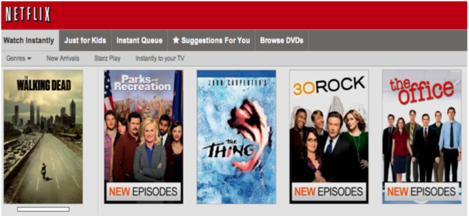
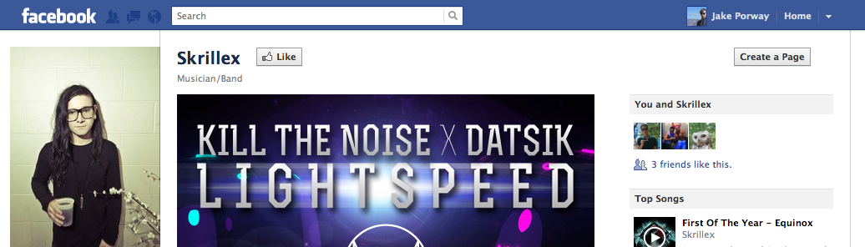
But what are we really driving?
Notes:
But what is it driving really? For all of the amazing breakthroughs we’ve had in the data world, the vast majority live in the private sector and enable things like better ad targeting or product recommendation systems.

Slide 4
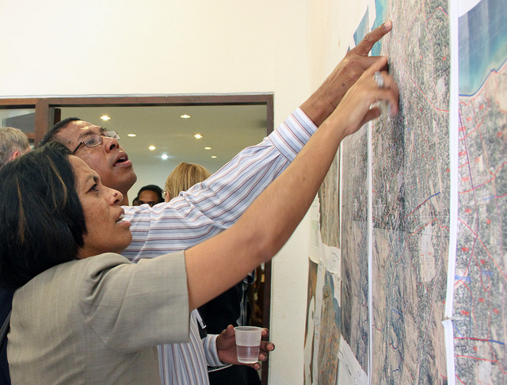
The Independent Sector
Notes:
So maybe we should look to the people already driving the real change, The Independent Sector – NGOs, non-profits, governments, foundations. They work every day to try to make the world a better place, but they have a lot of data problems.

Slide 5

Useful Government Stats are Disappearing
Notes:
Gov statistics like the CFFR and the decennial long form, that they used to rely on, are disappearing. [discussion about what the census is, why it’s awesome, why it’s going away, where that leaves orgs]

Slide 6
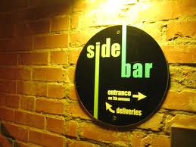
OpenGov Side Bar
Notes:
There is federal open data and municipal open data. There are three kinds of data: operational, administrative, statistical

Slide 7
Gov 1.75
Notes:
Open gov. Gov 2.0. Gov data for economic development. But “gov data” not all the same. And while gov 2.0 is advocating for open data, fed statistical system is languishing.

Slide 8
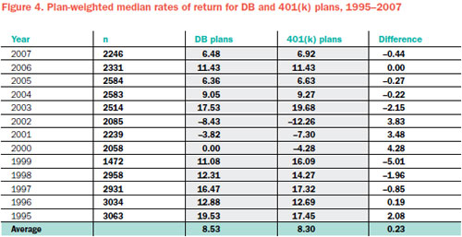
BrightScope
Notes:
BrightScope

Slide 9
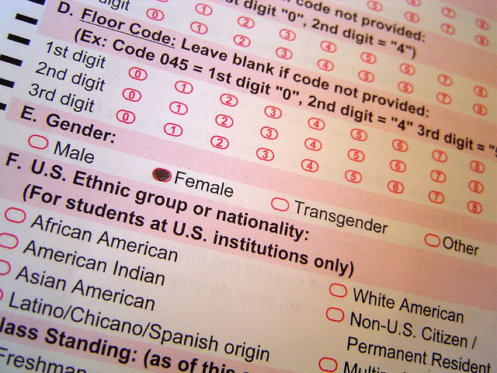
Internal and Project Data
Notes:
Some data is created from internal practices or projects that could be taken advantage of, but is usually just compiled into a report for funders. Not used to build out good data tools.

Slide 10
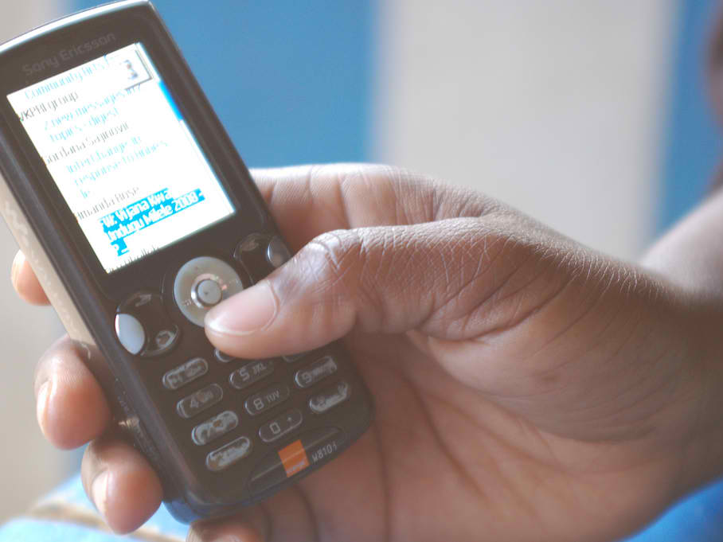
Data Exhaust Opportunities
Notes:
As programs increasingly use cellphones and websites (e.g. Fox Foundation’s clinical trial finder) there’s data that comes about as a result of their clients using these services that could be captured, learned from, have tools built on, etc.

Slide 11

Lack of Capacity
Notes:
Turns out one of the big reasons for these aside from lack of data is lack of capacity. Few data experts and few resources to get more.

Slide 13
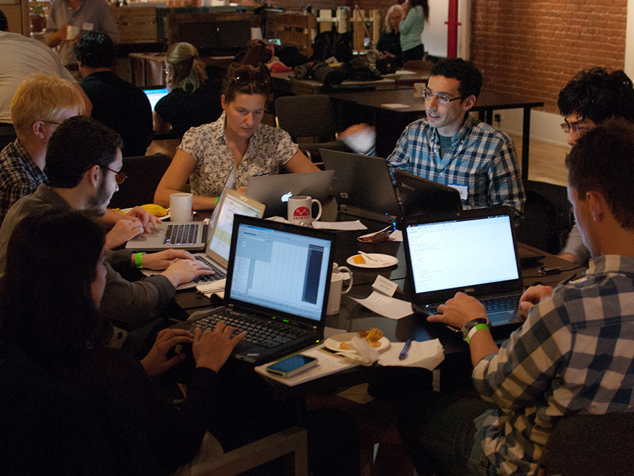
Data Scientists!
Notes:
Data scientists! You scrape, clean, analyze, visualize, build tools on data all day! And more than that, you do it all night! You’re at this conference you’re going to hackathons you’re excited to help! This is the first year more keynotes than not have been talking about doing more with the skills and data we have (quote some). So how do we get the excitement of the data science community to bear on the social sector?

Slide 14
How Can We Get These Two Together??
Notes:
So those are some big problems - not enough usable data, not enough high quality data, no capacity to look at data if those problems are solved. Hey, I know some people who deal with those problems all the time…

Slide 15

Metro Chicago
Information Center
Data Without Borders
Data Science for the Social Good
Notes:
Us! That’s what we both do!
MCIC – (spotlight Virginia!)
DWB – (Spotlight Jake!)
Definitely mention Code for America, ScraperWiki, Kaggle here, who are doing great things in scraping, building gov tools, etc. We’re from these orgs though, so we’ll tell you what we do.
(I have 3 examples here, but I want your advice on which one or two to show)

Slide 16
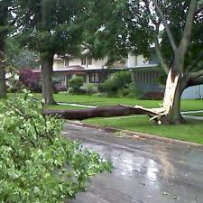
Power Outages

Slide 17
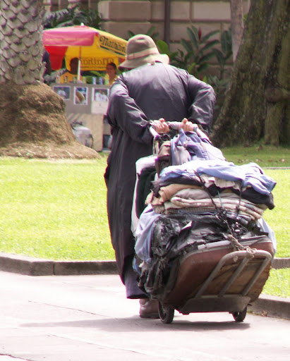

Slide 18


Notes:
Let me give you an example - the NY Civil Liberties Union works to uphold the civil rights of every New Yorker. They wanted to know if the NYPD was using racial discrimination. When they were stopped and frisked people in the streets, were they being racially biased? This is a very important question to their mission.
And what’s cool is that the NYPD actually makes a lot of data available about every time they stop and frisk someone, from where it happened, to what age the person was, to where it happened, to whether they had an AK47 on them. So here’s a great dataset that could help the NYCLU answer some really core questions and help them make some really important decisions. Great!

Slide 19
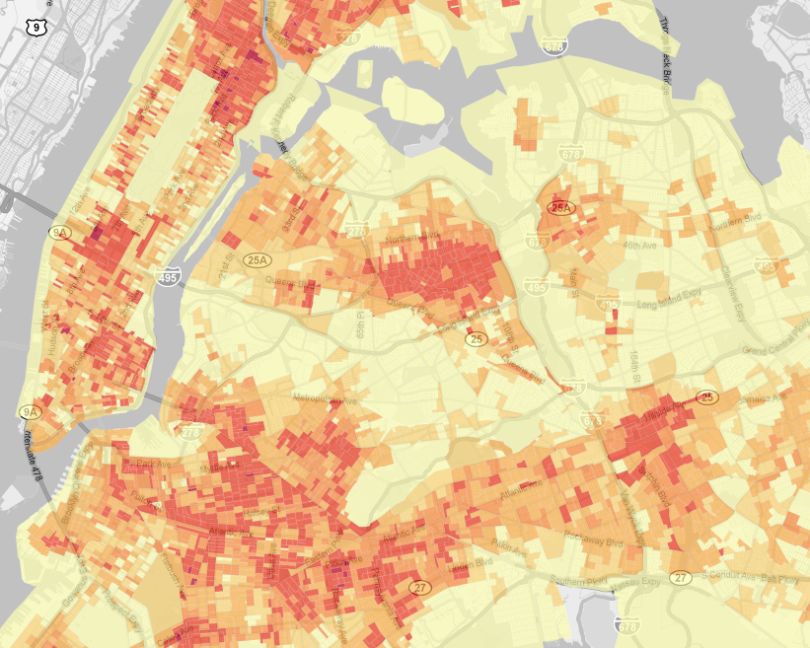
YEAR PCT SER.NUM DATESTOP TIMESTOP RECSTAT INOUT TRHSLOC PEROBS CRIMSUSP1 2010 78 81 1012010 340 1 O P 1 MISD 2 2010 26 21 1042010 1548 1 O P 2 ROBBERY 3 2010 18 34 1092010 1550 1 I T 1 MISD 4 2010 108 102 1112010 1120 A O P 5 BURGLARY 5 2010 23 2437 1222010 1620 1 O H 1 CPM 6 2010 26 299 1282010 1342 1 I T 5 PETIT LARCENY 7 2010 100 283 2012010 1603 A O P 1 CPW/ CRIMINAL TRESPASS 8 2010 30 834 2032010 1645 1 O T 2 220.39 / 195.05 9 2010 73 1686 2042010 1420 A O P 2 GLA 10 2010 100 493 2132010 2354 1 I T 10 FEL/ GRAND LARCENY 11 2010 107 1228 2202010 1350 A O P 3 ASSAULT 1 12 2010 24 470 2272010 1949 A O P 1 MISD 13 2010 28 1149 3012010 410 1 I T 5 ROBBERY 14 2010 28 1150 3012010 1232 1 I T 4 FORGERY 15 2010 17 267 3022010 1835 A O P 1 ROBBERY 16 2010 25 1954 3042010 1745 A I P 1 CPW/ROBBERY 17 2010 110 3912 3072010 1550 A O P 1 FEL 18 2010 44 1658 3072010 1930 A I P 1 MISD 19 2010 71 1551 3112010 15 A O P 2 CPW 20 2010 26 918 3232010 5 1 I T 5 PETIT LARCENY 21 2010 75 5151 3252010 1608 A O P 1 FELONY 22 2010 42 7 1012010 1 1 O P 2 CPW 23 2010 41 71 1012010 5 A I P 1 CPW 24 2010 114 105 1012010 10 1 O H 5 CPW 25 2010 79 44 1012010 10 A O P 2 FELONY 26 2010 32 393 1012010 15 A O P 2 FEL 27 2010 46 11 1012010 15 A O P 1 CPW 28 2010 32 475 1012010 15 A O P 2 FELONY 29 2010 120 798 1012010 15 A O P 5 CPW 30 2010 23 530 1012010 15 1 O P 1 ROBBERY 31 2010 23 529 1012010 15 1 O P 1 ROBBERY 32 2010 114 66 1012010 15 A O P 5 BURGLARY 33 2010 62 32 1012010 15 A O P 1 ROBBERY
Notes:
Here's the data. Can anyone tell me if racial discrimination is happening? Neither can I. And that ignores what it took to get this into this format. Unless you have a data scientist, this is probably where you stop. Or you try to struggle through it or contract it out, but that takes money and lots of time. Without an expert, this is what you’re stuck with and it’s where most groups give up.
Our volunteers worked together with NYCLU to help them see what was in this data and this is what they came up with. This is a tool that maps every stop and frisk in 2010 in each precinct by race, taking into account the number of people of that race in that precinct. Immediately you can SEE things here - up here there’s a high number of black people being stopped and frisked proportional to the number of blacks living there. You couldn’t SEE that in that list. You would never SEE that. So now you no longer have a block of numbers, you have a lens to help you understand. And while that doesn’t fully answer the question (that’s a tricky question) and gives you a place to start and to see and understand what’s going on.
And moreover, this tool doesn’t just help NYCLU answer important questions, it helps them ask important questinos. Oh, the map gets bright right before the end of the month, that's weird - does NYPD have a quota? That would be a violation of civil rights - that would be core to their mission and this would let them make those decisions better.
Oh and I almost forgot - how did this get made? We invited volunteers, those geeks from the hackathon built this. In under 24 hours. That’s incredible!

Slide 20


Notes:
The United Nations Global Pulse conducted an international survey of wellbeing where people responded via cellphone about how happy they were. Before the UN could even assess people’s wellbeing, however, they needed to know where the survey responses were coming from.

Slide 21
mid gender city year.school latitude longitude
29030 8ki6x9 Female Kochin 2009 NA NA
18107 5b6g4d Male baranqu\xcc_lla 2011 26.8205530 30.802498
29433 8ob0p6 Male tarakeswar 2011 -4.0500000 39.666667
2081 0od2qt Male Santa Clara 2008 5.5324624 5.898714
5153 1h5fyz Male mirpur 2011 7.1908544 5.157920
39485 bs6coy Male Port Moresby 2011 19.4500000 -70.700000
40952 dre34b Male San ferndando La Union 2009 NA NA
26004 7ogmpv Male santa cruz de la sierra 2009 10.3156992 123.885437
43017 lmht1f Male batangas 2011 NA NA
10311 2wv1pz Female Malang 1997 17.6868159 83.218481
32166 9fyl8d Female kingston 2006 NA NA
25899 7ncoeq Male Lima 2006 -6.2115440 106.845172
44990 t5frms Female Multan 2000 NA NA
4365 1bpskh Male Sonsonate 2007 31.0886523 77.179780
26754 7x31d4 Male noida 2009 61.5240100 105.318756
34717 abl3qw Female Abuja 2006 NA NA
22425 6k1lc5 Male bursa 2011 6.2359250 -75.575137
14977 4dzpct Male Mumbai 2008 5.5557170 -0.196306
39882 bwv914 Male Osun 2010 0.3136111 32.581111
8219 2bw76y Female SAO ROQUE 1997 14.5547290 121.02445
15985 4m23c6 Male habra 2005 -28.7500000 31.90000
39547 bt0hop Male enugu 2004 14.6133333 -90.53528
33135 9sbyhq Female escuintla 2010 -0.0951600 34.74733
37722 b7j0fs Male Puerto Princesa City 2008 10.9222560 108.10953
21410 69fxhg Female cebu city 1999 0.3136111 32.58111
18661 5gk4ft Male Santo Domingo 2010 -16.4990100 -68.14625
9230 2m91yl Male jaipur 2008 -33.9248685 18.42406
11201 37eqry Male San Miguel 2005 31.5450500 74.34068
19980 5tefrb Male palayan city 2009 -17.3841400 -66.16670
28653 8h1dfa Male Giza 2004 -7.5666667 110.81667
Notes:
Their data starts equally opaque…

Slide 22
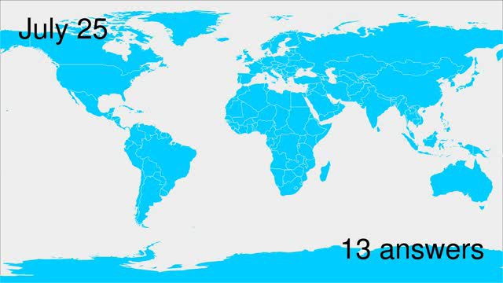
Notes:
But when put into a format like this, you can immediately see where people responded from and when.
This visualization by Paul Butler, a volunteer, was so important that it was used in a presentation to the UN General Assembly about the importance of using data for development., so tools like this are already being used to shape the international conversation on thinking about data.
But lest you think everything is mapping, social organizations have broad needs,

Slide 23
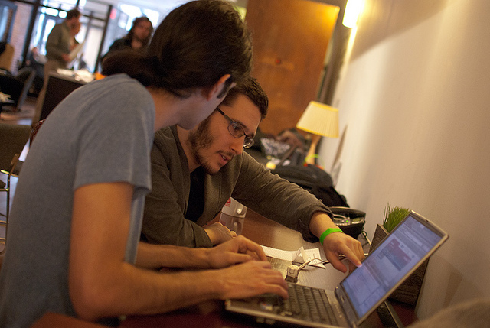
Why Stop There?
Notes:
So great. How awesome is it when the social sector and data people get together? So great.
But you know what? Let’s think bigger. Why stop there? We’re going to raise two interesting ideas to think about that this audience can help with and that we’re seeing brewing in the data + social good world:
More data for the common good, in particular private sector data
Multi-party collaborations

Slide 24

Commercial Data

Slide 25
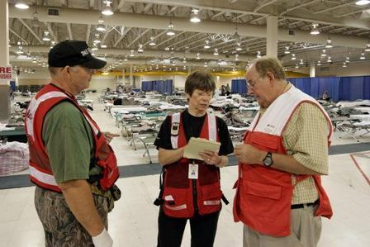
First Responders
Notes:
Getting ready for Katrina. What if first responders had known who to expect in a house, how many people, whether disabled or not, children or elderly?
Trulia

Slide 26
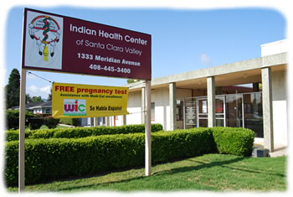

Target + Health Centers
Notes:
What if that data had been used another way? What if some anonymized aggregated form had been used to help this group, FQHC. Where are the people I need to reach out to? Can you point them to us instead?
See, Target has awesome private data. Think about the data sources of the rest of the private sector – LinkedIn, Google, OKCupid – what if we could get some of that beyond the wall? (GRANTED: Huge privacy / open data concerns. Just an idea right now)

Slide 27


Google + Aging Vision
Notes:
Another example, As vision becomes impaired, Google search results

Slide 29
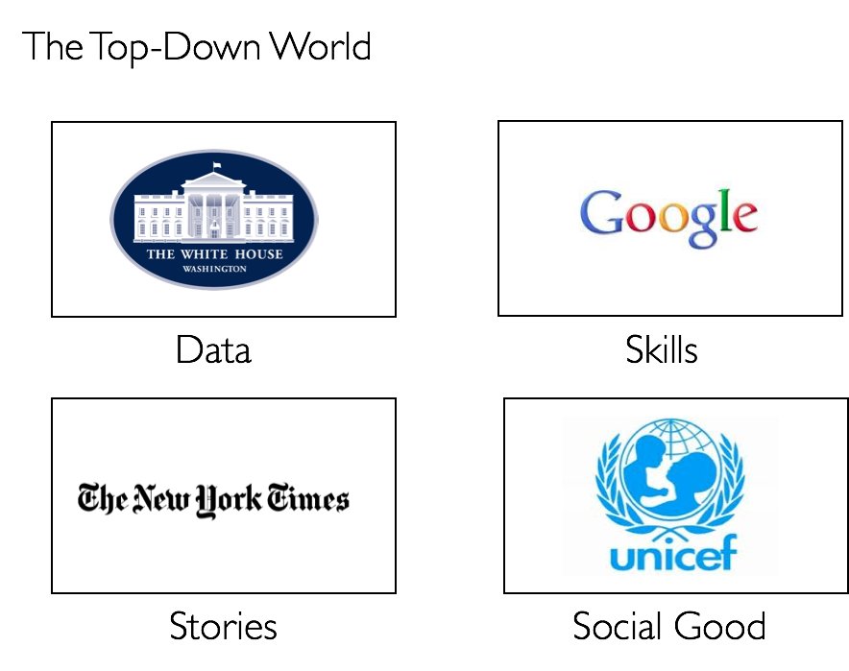
The Siloed World
Notes:
As you can see, we have a lot of groups that touch the data problem, but they’re all separate.
Gov’t has awesome data and vision, but doesn’t know where to direct the data.
Social orgs have the vision to help the world but don’t know where to get the data or how to use it.
Private sector has awesome data and most of the data scientists.
Data scientists have the skills and know what questions to ask, but don’t have the networks to connect it to the cause.
It’s a top-down world.

Slide 30
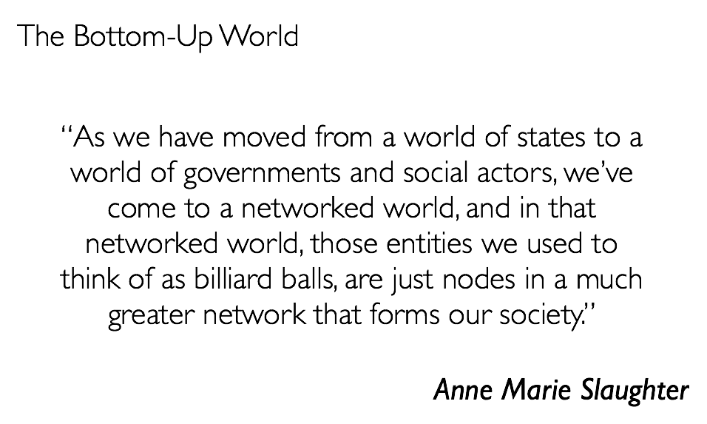
Notes:
What we need is a paradigm shift to a bottom-up world – civic hackers combining with data people and social orgs, governments lending

Slide 31
So What Next?
www.mcic.org
Virginia Carlson
@VL_Carlson
DC Datadive: http://dwb.cc/dcdatadive
Join us!
http://dwb.cc/join-dwb
@DataNoBorders
Notes:
Definitely mention Code for America and ScraperWiki here.

Slide 32
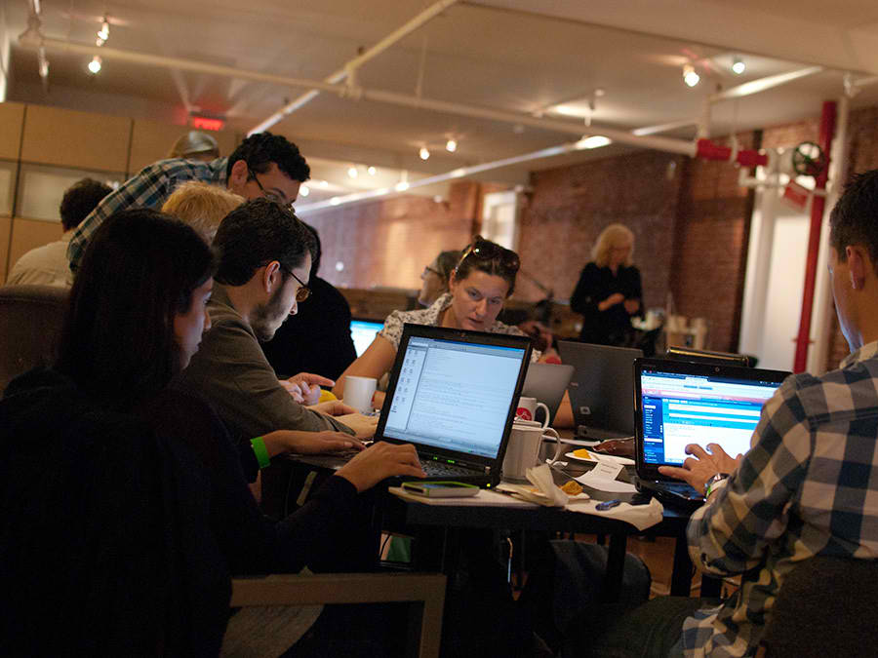
Notes:
So we’ll leave you with this thought: If this is what we do with just two communities, what could we do with your skills? What problems could we all solve with your community involved? What innovative ways could we come up with to bring data and skills to the independent sector in what we do? Come join us, bring your skills, because it’s only with all of our skills, with all of our efforts, when we’re all part of these transformative communities, that we can truly transform the world.

